Slide 1
Process Management
Dr. Deepamala.N
Associate Professor
RVCE

Slide 2
Process - A process is a program (object code stored on some media) in the midst of execution.
Some Operating systems were designed to manage only one process at a time (eg: PC_DOS, CP/M)
Modern OS are designed to manage multiple processes concurrently (eg: Windows, Unix/Linux)
These are more complex
As a process manager, OS must keep track of each process that is currently in existence, to facilitate cooperation among them and to mediate competing demands.
Kernel uses some special data structures to do this

Slide 3
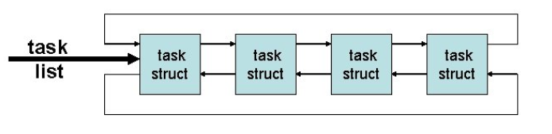
Process Control Block(PCB) or Task Record or task_struct
OS kernel creates a data-structure for each current process, known as process control block or task record or task_struct
The kernel stores the list of processes in a circular doubly linked list called the task list.
Each element in the task list is a process descriptor of the type struct task_struct, which is defined in <linux/sched.h>. The process descriptor contains all the information about a specific process

Slide 4
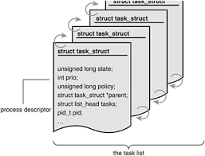
task_struct
Many important information are kept in Linux “task_struct” structure like pid, state of the process, priority of the process, process address space, pending signals, scheduling, virtual memory structures etc.
/usr/src/<linux..>/include/linux/sched.h
Threads also have task_struct allocated.
Task_Struct is allocated via slab allocator
Recent kernels have thread_info which stays in bottom of stack
This is processor independent PCB
Process Descriptor and task list

Slide 5
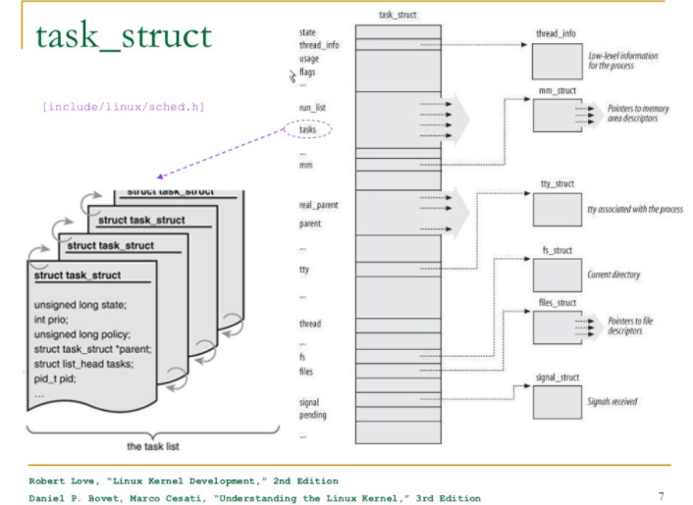

Slide 6
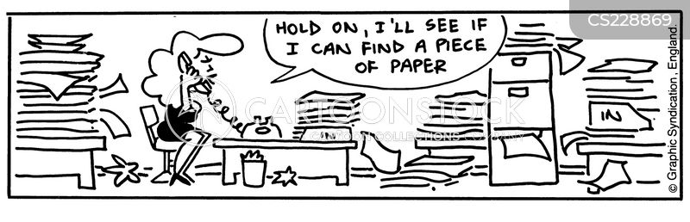
Threads
Processes may also have multiple threads.
Each thread has independent state, including program counter and stack, thus threads may be executed in parallel, but they all threads share same address space.
Each process and each thread has two stacks- kernel stack and user stack
Lets learn stacks and then come back

Slide 7
Why two different stacks when can manage with same?

Slide 8
Answer
A user space stack pointer is under the control of the (untrusted application). A buggy or malicious application could set the stack pointer to a bogus value.
Eg: A non existent address or an address inside the kernel

Slide 9
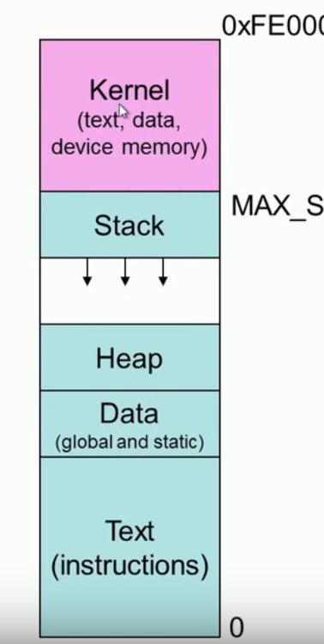
Kernel stack
All processes and their threads have their own kernel stack
For Separation of privileges and security.
Remember the only difference between processes and threads (to Linux) is the fact that multiple threads can share an address space (forming a process).
User space stack
All processes and threads have stack allocated in user address space.

Slide 10
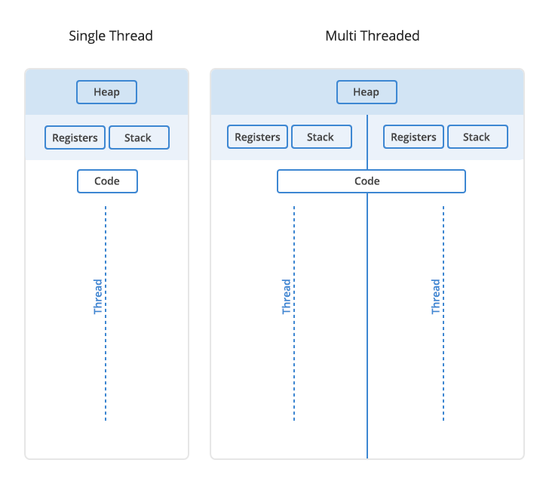
Each thread will have its own stack but share the heap
Threads are sometimes called lightweight processes because they have their own stack but can access shared data

Slide 11
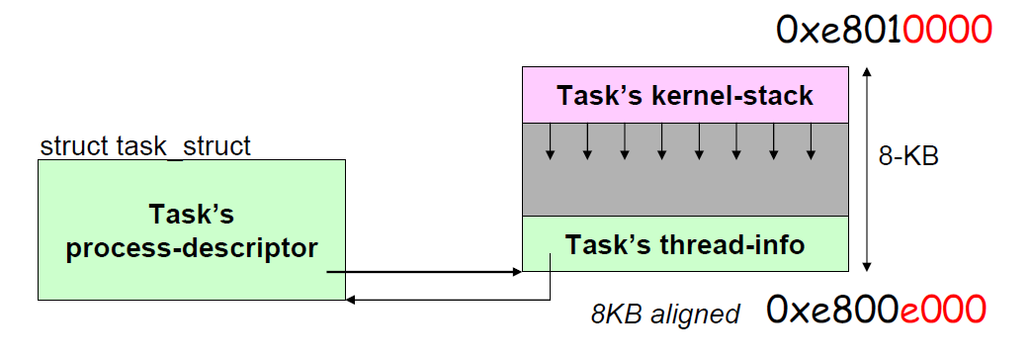
Thread_info
Linux uses part of a task’s kernel stack to store a structure thread_info
Thread_info and the task_struct contain pointers to each other

Slide 12
Know your stack size using command “ulimit –a” or “ulimit –s”
Stack size was changed from 4KB to 8KB in 2011
Some OS like Redhat 7.1 kernel has 16KB stack size
If stack size is 8KB, Each process only gets 8192 bytes of kernel stack, aligned to a 8192-byte boundary, so whenever the stack pointer is altered by a push or a pop, the low 13 bits are the only part that changes. 2^13==8192.

Slide 13
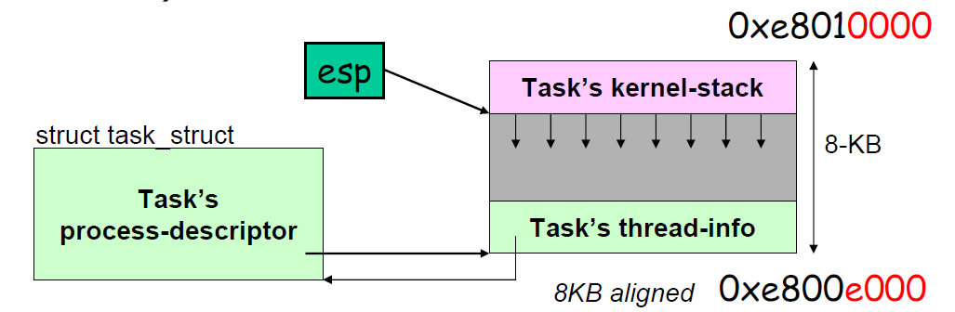
struct thread_info {
struct task_struct *task;
struct exec_domain *exec_domain;
__u32 flags;
__u32 status;
__u32 cpu;
int preempt_count;
mm_segment_t addr_limit;
struct restart_block restart_block;
void *sysenter_return;
int uaccess_err;
};
How to find thread_info from kernel stack?
movl $0xFFFFE000, %eax
andl %esp, %eax (mask out last 13 bits)
This assembly code is part of current_thread_info(), and return current_thread_info()->task

Slide 14
Storing the process descriptor
The system identifies processes by a unique process identification value or PID.
The PID is a numerical value represented by the type pid_t, which is typically an int.
Maximum value for PID is 32,768 (older values) for 64 bit systems its 2²² ie 4 million
Can be changed in /proc/sys/kernel/pid_max
init process has PID 1
To observe threads
Ps –T –p <pid>
For realtime view
Top –H –p <pid>

Slide 15
Assignment Slide
Explore various types of processes in Linux
Parent process
Child process
Orphan process
Zombie process
Daemon process
Check: ps -eo pid,ppid,status,cmd

Slide 16
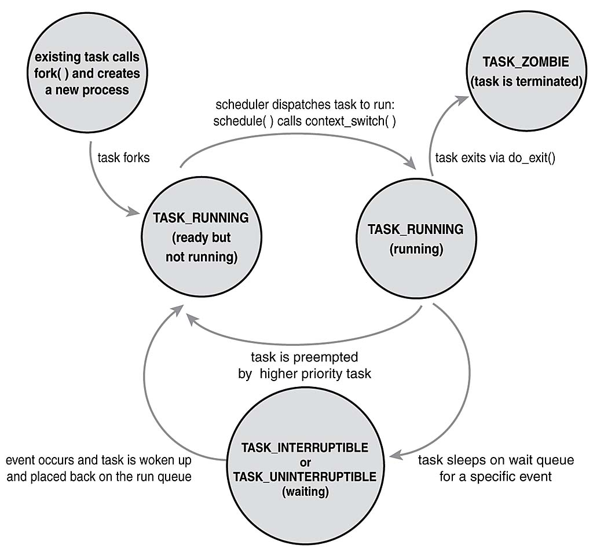
Process State

Slide 17
TASK_RUNNING—The process is runnable; it is either currently running or on a runqueue waiting to run (runqueues)
TASK_INTERRUPTIBLE—The process is sleeping (that is, it is blocked), waiting for some condition to occur.
TASK_UNINTERRUPTIBLE—This state is identical to TASK_INTERRUPTIBLE except that it does not wake up and become runnable if it receives a signal. This is used in situations where the process must wait without interruption or when the event is expected to occur quite quickly. Because the task does not respond to signals in this state, TASK_UNINTERRUPTIBLE is less often used than TASK_INTERRUPTIBLE.
TASK_TRACED—The process is being traced by another process, such as a debugger, via ptrace.
TASK_STOPPED—Process execution has stopped; the task is not running nor is it eligible to run.

Slide 18
Task Uninterruptible
One of the curious features of Unix systems (including Linux) is the "uninterruptible sleep" state.
This is a state that a process can enter when doing certain system calls.
mkdir system call is not interruptible
The process state is changed using
set_task_state(task, state);
Same as
task->state = state;

Slide 19
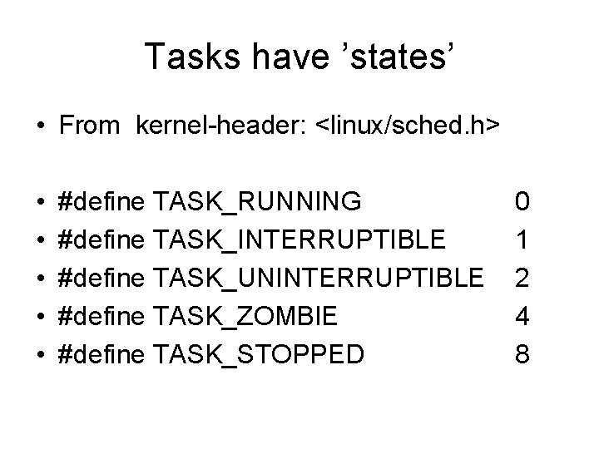
TO move to init from current process
for (task = current; task != &init_task; task = task->parent)
;
/* task now points to init */
To obtain the next task in the list, given any valid task, use
list_entry(task->tasks.next, struct task_struct, tasks)
Obtaining the previous task works the same way:
list_entry(task->tasks.prev, struct task_struct, tasks)

Slide 20
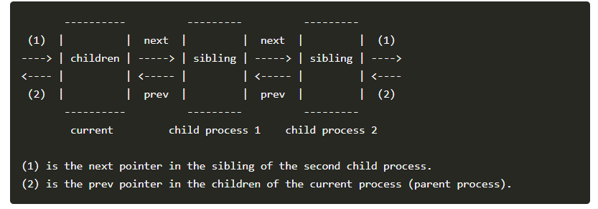
Print process children
Similarly, it is possible to iterate over a process’s children with
struct task_struct *task;
struct list_head *list;
list_for_each(list, &current->children) {
task = list_entry(list, struct task_struct, sibling);
/* task now points to one of current’s children */
}
Name: list_for_each — iterate over a list
Synopsis: list_for_each (pos, head);
Arguments: Pos :the struct list_head to use as a loop cursor, Head: the head for your list.
Name: list_entry — get the struct for this entry
Synopsis: list_entry (ptr, type, member);
Arguments: ptr - the struct list_head pointer.
Type - the type of the struct this is embedded in.
Member - the name of the list_head within the struct.

Slide 21
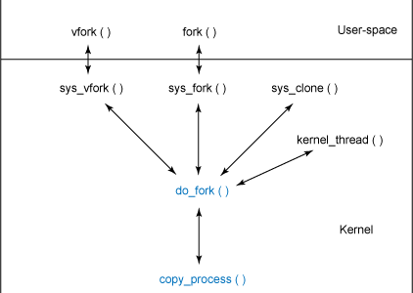
Process Creation

Slide 22
Process Creation – fork() fork calls-> clone -> do_fork (kernel/fork.c) Copy_process
Step 1:
It calls dup_task_struct(), which creates a new kernel stack, thread_info structure,
and task_struct for the new process. The new values are identical to those of
the current task. At this point, the child and parent process descriptors are identical.
Step 2:
It then checks that the new child will not exceed the resource limits on the number
of processes for the current user.

Slide 23
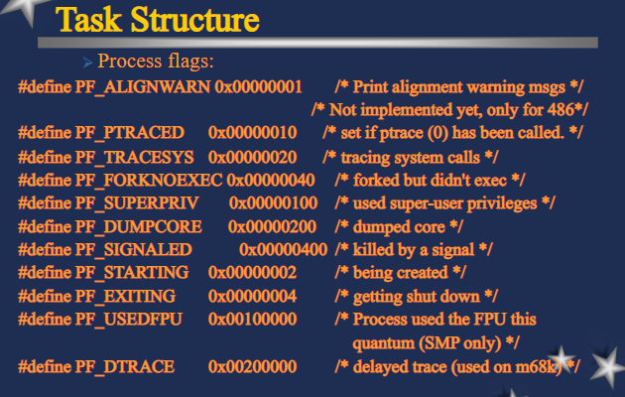
Step 3:
The child needs to differentiate itself from its parent. Various members of the process descriptor are cleared or set to initial values. Members of the process descriptor not inherited are primarily statistical information. The bulk of the values in task_struct remain unchanged.
Step 4:
The child’s state is set to TASK_UNINTERRUPTIBLE to ensure that it does not yet run.
Step 5:
copy_process() calls copy_flags() to update the flags member of the task_struct. The PF_SUPERPRIV flag, which denotes whether a task used superuser privileges, is cleared. The PF_FORKNOEXEC flag, which denotes a process that has not called exec(), is set.

Slide 24
Step 6:
It calls alloc_pid() to assign an available PID to the new task.
Step 7:
Depending on the flags passed to clone(), copy_process() either duplicates or
shares open files, filesystem information, signal handlers, process address space, and namespace. These resources are typically shared between threads in a given process; otherwise they are unique and thus copied here.
Step 8:
Finally, copy_process() cleans up and returns to the caller a pointer to the new
child.

Slide 25
Back in do_fork(), if copy_process() returns successfully, the new child is woken up and run. Deliberately, the kernel runs the child process first. (In fork parent or child can run first or simultaneously (multiple cores))
In the common case of the child simply calling exec() immediately, this eliminates any copy-on-write overhead that would occur if the parent ran first and began writing to the address space.

Slide 26
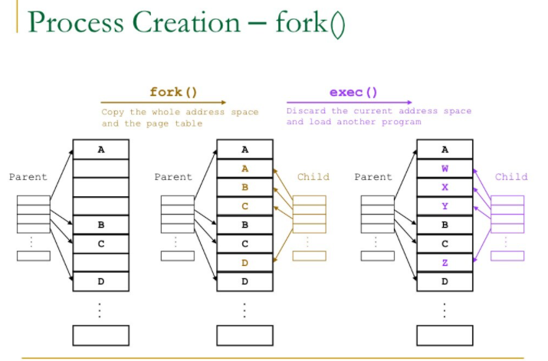

Slide 27
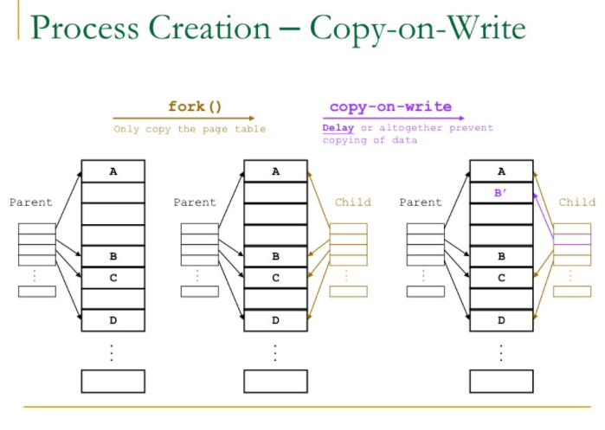
COW
Copy-on-write (or COW) is a technique to delay or altogether prevent copying of the data. Rather than duplicate the process address space, the parent and the child can share a single copy.

Slide 28
vfork
The vfork() system call has the same effect as fork(), except that the page table entries of the parent process are not copied. Instead, the child executes as the sole thread in the parent’s address space, and the parent is blocked until the child either calls exec() or exits.
The vfork() system call is implemented via a special flag to the clone() system call:
1. In copy_process(), the task_struct member vfork_done is set to NULL.
2. In do_fork(), if the special flag was given, vfork_done is pointed at a specific
address.
3. After the child is first run, the parent—instead of returning—waits for the child to
signal it through the vfork_done pointer.
4. In the mm_release() function, which is used when a task exits a memory address
space, vfork_done is checked to see whether it is NULL. If it is not, the parent is signaled.
5. Back in do_fork(), the parent wakes up and returns.

Slide 29
If this all goes as planned, the child is now executing in a new address space, and the parent is again executing in its original address space. The overhead is lower, but the implementation is not pretty.

Slide 30
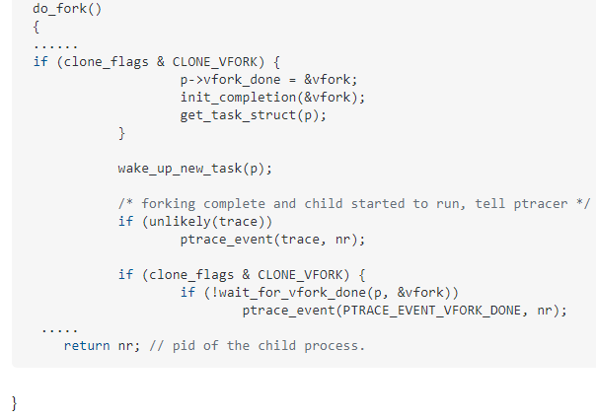
Shared PID (Shared Address space)
vfork suspends the parent process until the child terminates, so when vfork returns in the parent, the child has already exited and the new return value is able to be stored at the same location the old one was stored in the child.
Wait_for_vfork_done waits
For the child to complete and
Return the child pid.

Slide 31
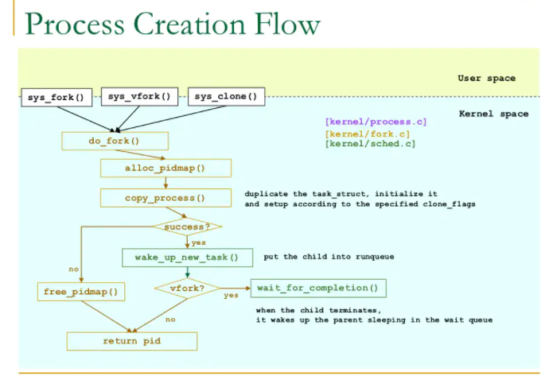

Slide 32
Linux Implementation of threads
Multiple threads are executed within the same program in a shared memory address space
They can also share open files and other resources. Threads enable concurrent programming and, on multiple processor systems, true parallelism.
Each thread has a unique task_struct and appears to the kernel as a normal process
We know that fork, vfork, threads: all call clone system call.
Creating threads
Clone system call is called for threads (with flags corresponding to specific resources to be shared)
clone(CLONE_VM | CLONE_FS | CLONE_FILES | CLONE_SIGHAND, 0);
Fork:
clone(SIGCHLD, 0);
Vfork:
clone(CLONE_VFORK | CLONE_VM | SIGCHLD, 0);

Slide 33
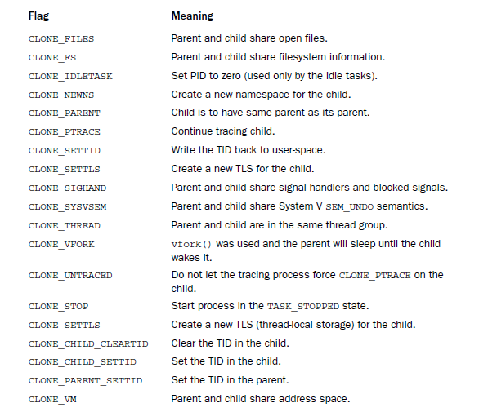

Slide 34
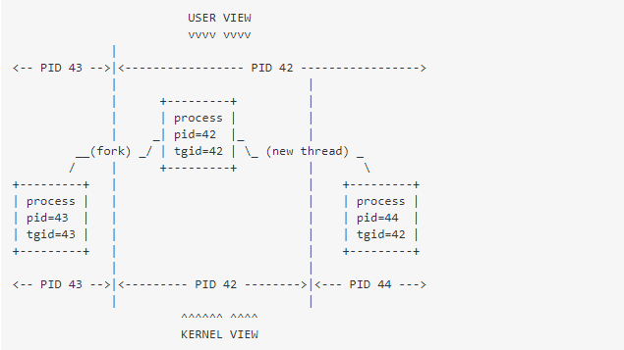
PID in threads
In user space the threads have same PID
check using command ps -T –p <pid> for user space details
Top –H –p <pid> for real-time view
In kernel threads have different task_Struct and different PID so that processor can schedule independently

Slide 35
Kernel Threads
kernel has to perform some operations in the background, the kernel accomplishes this via kernel threads
Examples are flush tasks and the ksoftirqd task
See kernel threads with “ps –ef”
The significant difference between kernel threads and normal processes is that kernel threads do not have an address space. (Their mm pointer, which points at their address space, is NULL.)
They operate only in kernel-space and do not context switch into user-space.
Kernel threads, however, are schedulable and preemptable, the same as normal processes

Slide 36
syntax
Syntax:
struct task_struct *kthread_create(int (*threadfn)(void *data),
void *data,
const char namefmt[],
...)
Arg1: Thread function is called on thread creation
Arg2: data argument is passed to thread function
Arg3: process is named namefmt
The process is created and will be in unrunnable state. It can be made to run with wake_up_process()

Slide 37
A process can be created and made runnable with a single function, kthread_run():
struct task_struct *kthread_run(int (*threadfn)(void *data),
void *data,
const char namefmt[],
...
This routine, implemented as a macro, simply calls both kthread_create() and
wake_up_process():
#define kthread_run(threadfn, data, namefmt, ...)
({
struct task_struct *k;
k = kthread_create(threadfn, data, namefmt, ## __VA_ARGS__);
if (!IS_ERR(k))
wake_up_process(k);
k;
})

Slide 38
To stop the thread
int kthread_stop(struct task_struct *k)
Input is the address of the task_struct structure returned by kthread_create():

Slide 39
Process Termination
Process termination occurs when:
1. The process calls the exit() system call, either explicitly when it is ready to terminate.
2. Implicitly on return from the main subroutine of any program (here C compiler calls exit after main() returns).
3. Process may terminate involuntarily when it receives a signal or exception it cannot handle
Whatever may be the reason, exit is handled by do_exit() (kernel/exit.c)

Slide 40
Step 1:
It sets the PF_EXITING flag in the flags member of the task_struct.
Step 2:
It calls del_timer_sync() to remove any kernel timers. Upon return, it is guaranteed that no timer is queued and that no timer handler is running.
Step 3:
If BSD process accounting is enabled, do_exit() calls acct_update_integrals() to write out accounting information
Step 4:
It calls exit_mm() to release the mm_struct held by this process. If no other process is using this address space—that it, if the address space is not shared—the kernel then destroys it.
Step 5:
It calls exit_sem(). If the process is queued waiting for an IPC semaphore, it is dequeued here
Step 6:
It then calls exit_files() and exit_fs() exit_namespace, exit_sighand to decrement the usage count of objects related to file descriptors and filesystem data, respectively. If either usage counts reach zero, the object is no longer in use by any process, and it is destroyed.

Slide 41
Step 7:
It sets the task’s exit code, stored in the exit_code member of the task_struct, to the code provided by exit() or whatever kernel mechanism forced the termination. The exit code is stored here for optional retrieval by the parent
Step 8:
It calls exit_notify() to send signals to the task’s parent, reparents any of the task’s children to another thread in their thread group or the init process, and sets the task’s exit state, stored in exit_state in the task_struct structure, to EXIT_ZOMBIE
Step 9:
do_exit() calls schedule() to switch to a new process. Because the process is now not schedulable, this is the last code the task will ever execute. do_exit() never returns.
Process is in the EXIT_ZOMBIE exit state. The only memory it occupies is its kernel stack, the thread_info structure, and the task_struct structure. The task exists solely to provide information to its parent. After the parent retrieves the information, or notifies the kernel that it is uninterested, the remaining memory held by the process is freed and returned to the system for use.

Slide 42
Removing the Process Descriptor
Process is in zombie state, After the parent has obtained information on its terminated child, or signified to the kernel that it does not care, the child’s task_struct is deallocated.
The wait() family of functions are implemented via a single (and complicated) system call, wait4().
The standard behavior is to suspend execution of the calling task until one of its children exits, at which time the function returns with the PID of the exited child.
Release_task()
1. It calls __exit_signal(), which calls __unhash_process(), which in turns calls detach_pid() to remove the process from the pidhash and remove the process from the task list.
2. __exit_signal() releases any remaining resources used by the now dead process and finalizes statistics and bookkeeping.
3. If the task was the last member of a thread group, and the leader is a zombie, then release_task() notifies the zombie leader’s parent.
4. release_task() calls put_task_struct() to free the pages containing the process’s kernel stack and thread_info structure and deallocate the slab cache containing the task_struct

